Slide 1
Chapter 2
How to Write a Scientific Paper

Slide 2
Think About…
What is the clear structure of a scientific paper? Which sections do you need to address in detail?
What contents does an abstract usually include? What aspect should you importantly show in this paragraph?
How many words around are necessary for an abstract?
Is it better to write the abstract after the rest of paper is completed?
Can an abstract refer to other parts of the paper or figures/tables?

Slide 3
Think About…
What contents does an introduction usually include? What does the “setting” mean? What does the “gap” mean?
What is addressed in a conclusion section?
What should be described in the main part of a scientific paper?
Is it important to cite the literature carefully and fully according to the requirement of the journal or conference proceeding you submit to?
What tips have you obtained from this chapter?

Slide 4
The Clear Structure of a Scientific Paper
Abstract
Keywords
Introduction
Method
Result
Discussion (optional)
Conclusion and future work
Reference

Slide 5
Abstract
Abstract is a single paragraph with concise summary of the entire paper that includes background, purpose, method, result and conclusion in the research
Most importantly, you should show the originality of your research in this section, otherwise people may not have interest in reading the following contents

Slide 6
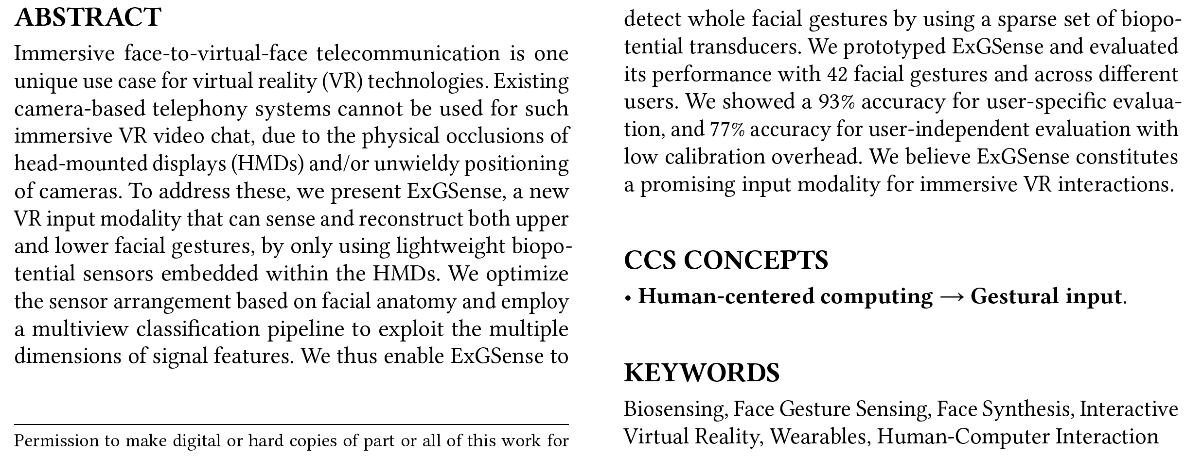
Abstract
Example

Slide 7
Abstract
An abstract is usually written in no more than two hundred words
It is easier to write the abstract after the rest of paper is completed. After all, it is difficult to summarize something that is not yet written
An abstract should stand on its own, and NOT refer to any other part of the paper including figures and tables.
This summary focuses on the proposed method and result, and limits background information to a sentence or two, or even omits if not absolutely necessary

Slide 8
Introduction and Conclusion
Introduction is actually the extension of the abstract. This section gives the reader an initial overview of this work. It usually includes setting, review of literature, gap/purpose, method, result, and overview of the contents

Slide 9
Introduction
Setting means opening up the subject. Your subject may be nonverbal language in human-computer interaction, face detection in images, or whatever. Setting lets the reader see your research area at a glance
Review of literature means surveying the past work relevant to this paper. Here you should mention previous works and both of their contribution and limitation
Then you indicate the current gap or the problem that will be resolved in your paper, and what your research motivation or purpose is
Next introduce your method, and briefly describe what have been done and achieved from this work
Finally overview the contents in this paper to give a clear clue

Slide 10
Conclusion
Conclusion simply summarizes what has been accomplished in this paper. This section reemphasizes the main purpose or hypothesis of this work, reviews findings, describes advantages and limitations as well, and recommends possible applications and future direction

Slide 11
Note
Many readers would read only the introduction and conclusion of your paper. The two sections must be written carefully and thoroughly, so the basic idea of your research can be understood by someone who does not read the main body of your paper. In addition, you should define all the terminologies, notations, and abbreviations to be used first in introduction section.

Slide 12
Main body of a paper
The main body of a paper consists of the method, result and discussion (optional)
From developing the equations on which your research is based to describing your methodology or algorithm step by step, you should do your best to let the result or achievement be obtained smoothly and understandably

Slide 13
Reference
Peer reviewers judge what your work is based on by looking through your references
The source and range you have read about decide your research level, so cite your literature carefully and fully according to the requirement of the journal or conference proceeding you submit to

Slide 14
Conference Paper Citation
Y. Lu, L. Zhang, Q. Tian, and W-Y. Ma, “What are the high-level concepts with small semantic gaps?,” in Proc. Int. Conf. Computer Vision and Pattern Recognition, Anchorage, USA, Jun. 2008, pp.1-8.
N. Hervé and N. Boujemaa, “Image annotation: which approach for realistic databases?,” in Proc. ACM Int. Conf. Image and Video Retrieval, Amsterdam, Netherlands, Jul. 2007, pp.170-177.

Slide 15
Journal Paper Citation
J. Li and J.Z. Wang, “Real-time computerized annotation of pictures,” IEEE Trans. PAMI, vol. 30, no. 6, pp. 985-1002, Jun. 2008.
Y. Liu, D.S. Zhang, and G.J. Lu, “Region-based image retrieval with high-level semantics using decision tree learning,” Pattern Recognition, vol. 41, no. 6, pp. 2554-2570, Aug. 2008.

Slide 16
Book Citation
侯进编著，《计算机专业实用英语》，电子工业出版社，ISBN 978-7-121-07754-8, 2009.1.
J. Hou and Y. Aoki, “Let the sign language speak on your screen: an intelligent sign language synthesizing system,” in Digital Media Processing for Multimedia Interactive Services, E. Izquierdo, Ed. , London: World Scientific, 2003, pp. 351–354.

Slide 17
Unpublished Paper Citation
J. Zhao, J. Hou, T. Zhu, F. Wang, Y. Liu, X. Yin, “Uniaxial Tensile Behavior of a Bicrystal Copper Nanowire: Structural Characterization with a Fourier Transformation Method,” Computational Materials Science, to be published.

Slide 18
Citation Mistake
Y. Jing, and S. Baluja, “Pagerank for product image search, ” in Proc. Int. Conf. World Wide Web, China, pp. 307-316, Apr. 2008.
Y. Jing_and S. Baluja, “Pagerank for product image search” , in Proc. Int. Conf. World Wide Web, Beijing, China, Apr. 2008, pp. 307-316.

Slide 19
Citation Mistake
J. Li and J.Z. Wang, “Automatic linguistic indexing of pictures by a statistical modelling approach,” IEEE Trans. PAMI, Sep. 2003, vol. 25, pp. 1075——1088.
J. Li and J. Z. Wang, “Automatic linguistic indexing of pictures by a statistical modelling approach,” IEEE Trans. PAMI, vol. 25, pp. 1075-1088, Sep. 2003.

Slide 20
Useful tricks
Finish a complete draft first. In writing your first draft, don’t worry if the wording is not perfect or the grammar is not correct, but just put down the words as you are explaining what you are working on to a very good friend. Polishing the paper comes later!

Slide 21
Useful tricks
Express your ideas as concisely as possible. Make sure that your materials are easy for a reader to follow. Keep in mind that your readers probably understand less than you think. Each paragraph should only have one main point. It is recommended to state the central point in a topical sentence at beginning of the paragraph. Avoid mixing different ideas in the same paragraph

Slide 22
Useful tricks
Avoid foggy writing. Reduce the length of your sentences by breaking long sentences into shorter ones. Get rid of as many complicated words as possible by using simpler words instead. Get rid of as many abstract words as possible, because abstract words often convey a different meaning to the reader than the one you intended

Slide 23
Useful tricks
Use verbs more than nouns. Let the verbs carry the action, so that your writing will sound better than burying the main action in nouns or adjectives. For example, compare “It is our expectation that the input will be expanded into other natural languages in future.” with “We expect to expand the input into other natural languages in future.”, then you can tell the different effect

Slide 24
Useful tricks
Keep verb tense consistent. Don’t change verb tense frequently between the future and present tense for no reason. The simplest way is just to stick to the present tense. For example, “We propose a novel method in this paper.”, instead of “We shall propose a novel method in this paper.”

Slide 25
Useful tricks
Get rid of as many passive verbs as possible, because passive verbs often make writing obscure, incomprehensible, and even boring

Slide 26
Useful tricks
Transition between ideas or paragraphs must go smoothly. Make sure that the reader always has a roadmap of your paper in mind. The reader must always be able to understand what you have described and what you are going to talk about

Slide 27
Useful tricks
Do not use “this” or “that” as a pronoun, otherwise the antecedent is often missing or poorly defined. The solution to this problem is to change “this” to an adjective by inserting a suitable noun. For example, avoid using sentence such as “this is…”, and instead, use “this problem is…” or “that result is…” and so forth

Slide 28
Useful tricks
Polish your paper as perfect as possible. Watch out for subtle grammar mistakes, sentence rhythm and timing. Make sure that the ideas flow clearly, simply and smoothly, and the entire paper looks just fine and pleasing. If some section does not quite sound right, work on it some more until it looks satisfying

Slide 29
Above All
Practice makes perfect! Read and write more, and you will get better at this step over time as you develop a feel for clearly scientific writing

Slide 30
Class Task
Write an abstract of your work in no more than 200 words.

Slide 31
Example

Slide 32
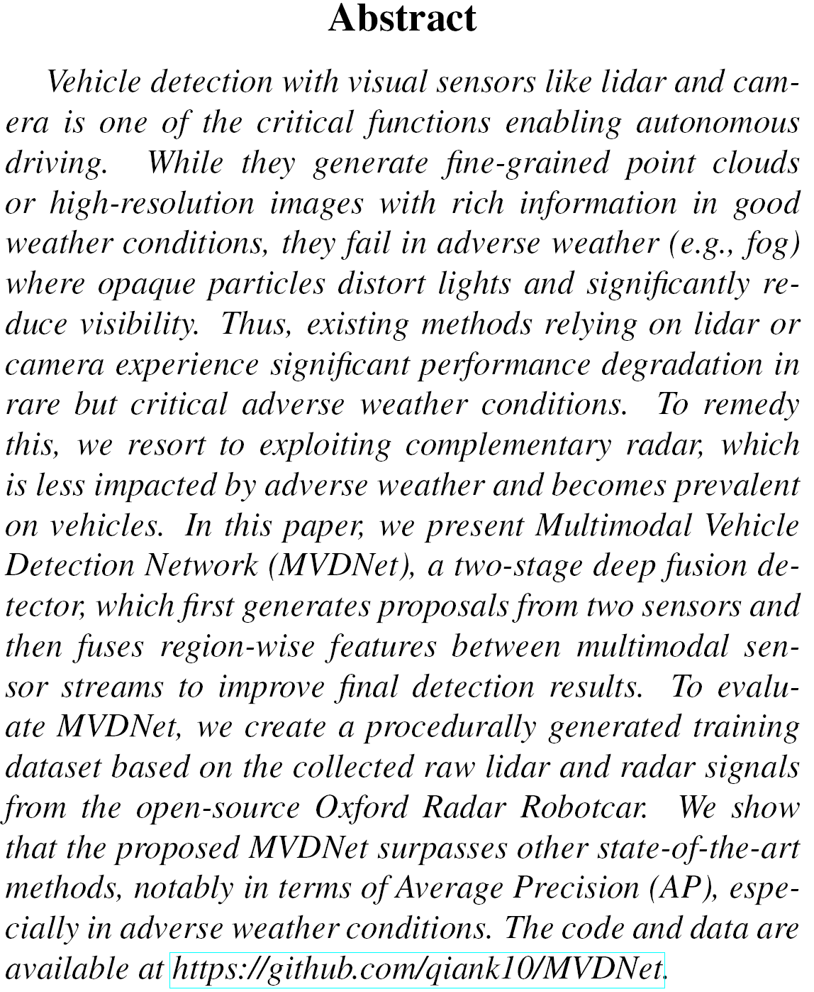
Example

